Slide 1
Topics
Use of finally clause in Exception Handling
Some Important Facts About Exceptions

Slide 2
Use of finally clause (statement)
finally block in general used to perform certain house keeping operations such as closing files or releasing system resources.
finally block may be added immediately after try block or after the last catch block.
finally block when present is guaranteed to execute regardless of whether an exception is thrown or not.
If required , finally block can be used to handle any exception generated within a try block.

Slide 3
finally clause Syntax
// Immediately After try() block
try
{
…………………..
…………………..
} // End of try
finally
{
…………………..
…………………..
} // End of finally
catch(Exception-Type-1 e) { … }
catch(Exception-Type-2 e) { … }
…
catch(Exception-Type-N e) { … }
// After the last catch() block
try
{
…………………..
…………………..
} // End of try
catch(Exception-Type-1 e) { … }
catch(Exception-Type-2 e) { … }
…
catch(Exception-Type-N e) { … }
finally
{
…………………..
…………………..
} // End of finally

Slide 4
finally clause Example
// File Name ExceptionDemo.java
class ExampleFinallyClause
{
public static void main(String args[])
{
int a=10;
int b = 20;
try // Outer Try
{
int b1=Integer.parseInt(args[0]);
int x = a/(a-b1);
try // Inner try
{
int y = b/(b-b1);
} // End of Inner try
finally
{
System.out.println("Inner Block executed");
} // End of finally clause
} // End of Outer try
finally
{
System.out.println("Outer Block executed");
} // End of finally clause
} // End of main() Method
} // End of class

Slide 5
finally clause Example …
java ExampleFinallyClause
Outer Block executed
Exception in thread "main" java.lang.ArrayIndexOutOfBoundsException: 0 [Partial Output Shown]
java ExampleFinallyClause 45
Inner Block executed
Outer Block executed
java ExampleFinallyClause 10
Outer Block executed
Exception in thread "main" java.lang.ArithmeticException: / by zero [Partial Output Shown]
java ExampleFinallyClause 20
Inner Block executed
Outer Block executed
Exception in thread "main" java.lang.ArithmeticException: / by zero [Partial Output Shown]

Slide 6
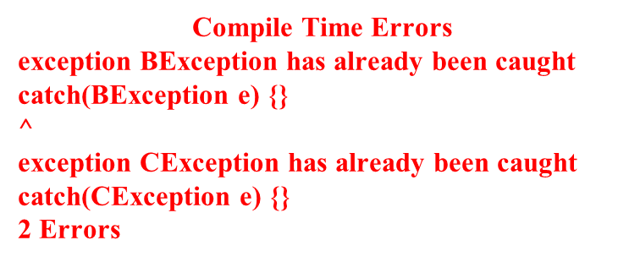
Some Important Facts About Exceptions
Fact I : A super class exception type can catch all sub class exceptions. So, while writing catch blocks , catch sub class exceptions first and then super class exceptions
class AException extends RuntimeException { }
class BException extends AException { }
class CException extends AException { }
class Demo
{
public static void main(String args[])
{
try
{
int a=10;
}
catch(AException e) { }
catch(BException e) { }
catch(CException e) { }
} // End of method
} // End of class
RuntimeException
AException
BException
CException

Slide 7
Some Important Facts About Exceptions
Fact I : A super class exception type can catch all sub class exceptions. So, while writing catch blocks , catch sub class exceptions first and then super class exceptions
class AException extends RuntimeException { }
class BException extends AException { }
class CException extends AException { }
class Demo
{
public static void main(String args[])
{
try
{
int a=10;
}
catch(BException e) { }
catch(CException e) { }
catch(AException e) { }
} // End of method
} // End of class
RuntimeException
AException
BException
CException
NO ERROR

Slide 8
Some Important Facts About Exceptions
Fact II : An overridden method in sub-class can not throw an exception broader and stronger than the method of the super class
// File Name : ExceptionDemo.java
import java.io.*;
class A
{
public void display() throws IOException
{
}
}
class B extends A
{
public void display() throws Exception
{
}
}
Compile-Time Error
ExceptionDemo.java:11: display() in B cannot override display() in A; overridden method does not throw java.lang.Exception
public void display() throws Exception
^
1 error

Slide 9
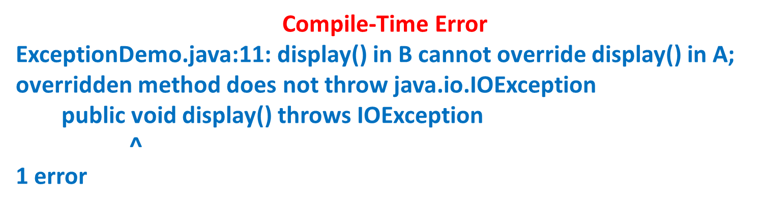
Some Important Facts About Exceptions
Fact II : An overridden method in sub-class can not throw an exception broader and stronger than the method of the super class
// File Name : ExceptionDemo.java
import java.io.*;
class A
{
public void display() throws RuntimeException
{
}
}
class B extends A
{
public void display() throws IOException
{
}
}

Slide 10
Thank You

